Slide 1
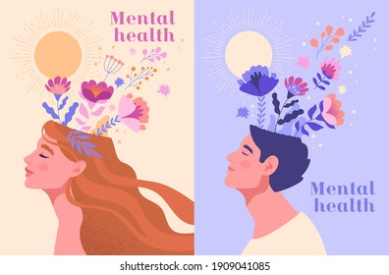
What is mental health awareness?
By freya 8-h AND MAIA 8-I :))

Slide 2
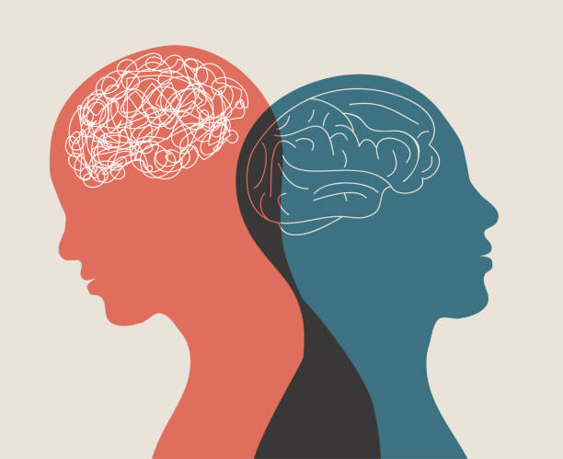
What is mental health awareness?
Mental health awareness is the ongoing effort to reduce the stigma around mental illness and mental health conditions by sharing our personal experiences. Often, because of misconceptions about mental health and mental fitness, people often suffer in silence and their conditions go untreated.

Slide 3
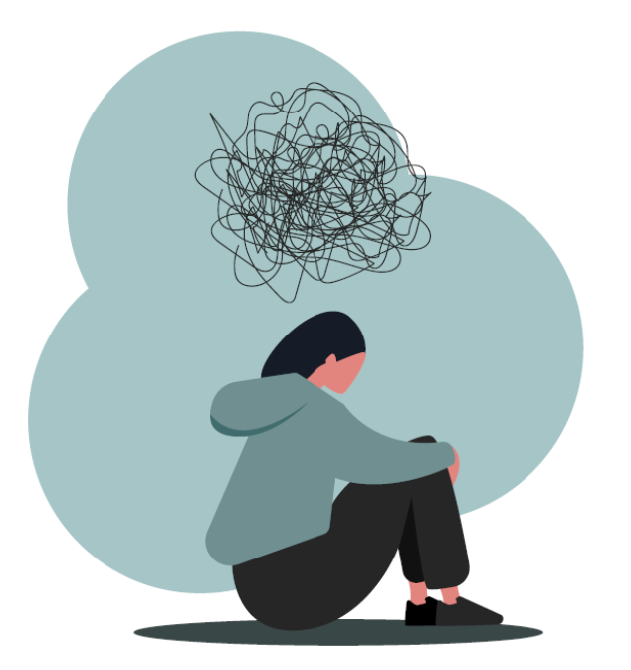
What is mental health awareness and why is it so important?
Mental health awareness helps educate the public at large. It teaches them that it is okay to share experiences, vulnerabilities, and shared concerns about mental health issues. Reducing the stigma which has been attached to mental health will help countless others.

Slide 4
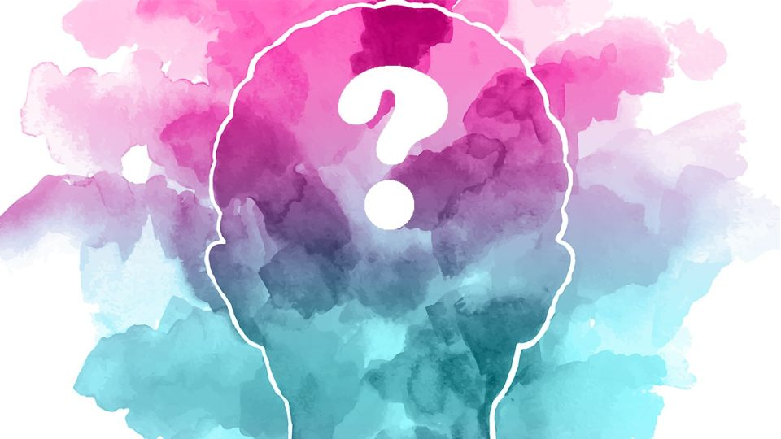
What is the aim of mental health promotion?
Mental health promotion attempts to encourage and increase protective factors and healthy behaviors that can help prevent the onset of a diagnosable mental disorder and reduce risk factors that can lead to the development of a mental disorder.

Slide 5
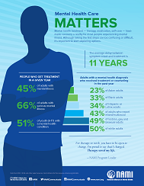
Here is 5 facts about mental health.
1: More than 31 million British people struggle with mental illness.
2: 1 in 5 young people (age 13-18) has or will develop a mental illness in their lifetime.
3: Youth depression rates have risen from 5.9% to 8.2% since 2012.
4: Most Britain's lack access to adequate mental health treatment.
5: Mental illnesses can affect people of any age, race, religion, or income. A mental illness is a medical condition that disrupts a person’s thinking, feeling, mood, and ability to relate to others and daily functioning.

Slide 6
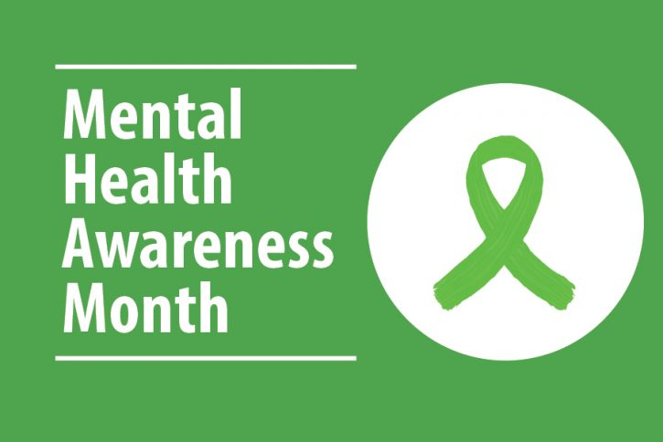

What colour represents mental health?
The green ribbon is international symbol of mental health awareness. Wear a green ribbon to show colleagues, loved ones or simply those you walk past that you care about their mental health.

Slide 7
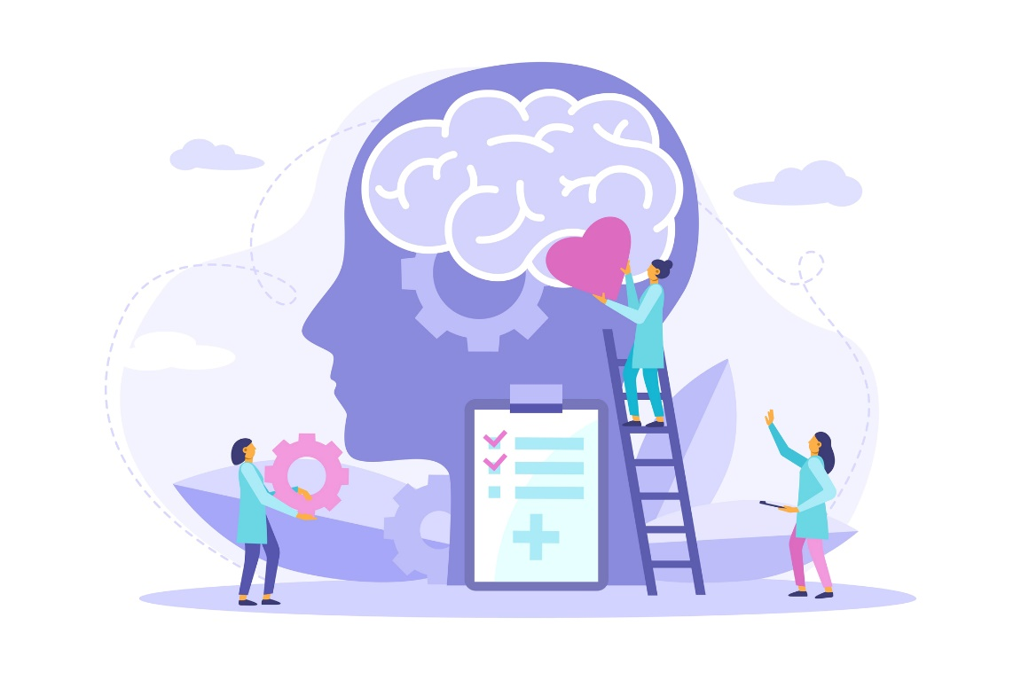
What is a mental health campaign?
The campaign aims to raise awareness of mental health issues and mobilize efforts in support of mental health. The world health organization recognizes world mental health on 10 October every year. The theme of 2022s world mental health, set by the world federation for mental health, is make mental health and wellbeing for all global priority.

Slide 8
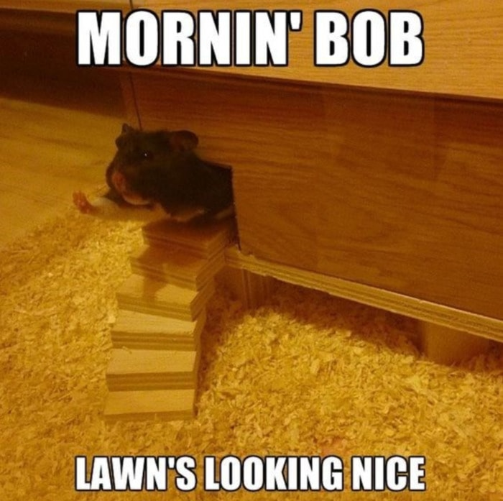

Thank you for listening! <3

